Slide 1
Title
A light weight randomized low sampling compression technique verified by GI with merits over CR and IT reconstruction schemes
Guide
Dr. R. Bhakthavathsalam
Principal Research Scientist
Dept of SERC
Indian Institute of Science
Bangalore
Team Members
Abhishek Sharma.R
Chaitra Suresh
Chandan S
College: BNMIT

Slide 2
Problem Statement
To sample a given analog signal at a rate much lower than the Nyquist rate suggested by the Nyquist-Shannon sampling theorem and reconstruct the original signal using Convex Relaxation(CR), Greedy Iterative(GI) and Iterative Thresholding(IT) reconstruction schemes.

Slide 3
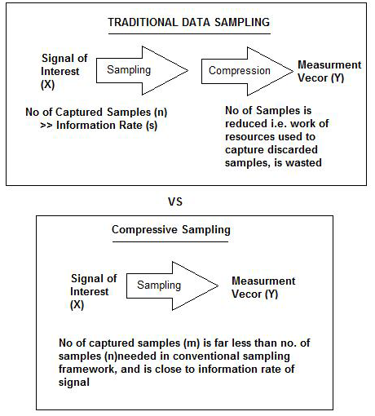
Introduction
The entire signal can be determined accurately from relatively few measurements.
Compressed sensing challenges the traditional sample first-then compress procedure.

Slide 4
System Architecture
Sampling
Input Signal
OMP
Reconstruction
Basis Pursuit
AMP
Reconstructed
Signal

Slide 5
Implementation
Sampling
Input: Signal to be sampled ‘f’
Basis matrix(Ψ) is applied to the input signal.
The vector ‘c’ consisting of major frequency components of the signal is obtained
Sampling matrix(Φ) is applied to vector c, Random Samples ‘b’ are obtained.
Output: Frequency samples of the input signal ‘b’
Reconstruction
Input: Samples of the input signal ‘b’
Express the problem to be solved in the form ‘Ax=b’ where A= Φ Ψ and ‘x’ is the solution to be found. Express this as an optimization problem.
Solve the problem using any of the following algorithms:
Basis Pursuit
Approximate Message Passing
Orthogonal Matching Pursuit
Output: Reconstructed signal

Slide 6
Testing
Sampling Module:
Valid key entered?
Is the number of samples taken the same for all inputs?
Is the data being written into a file?
Is this file sent successfully?
Reconstruction Module:
Is the file received successfully?
Are the contents of the file read properly?
Is the reconstruction successful?

Slide 7
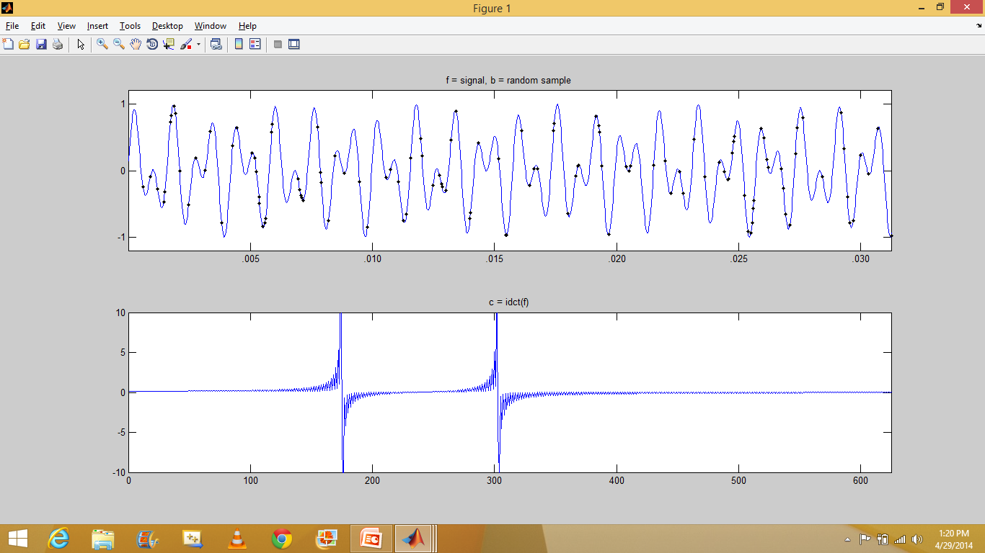
Results
Original Signal

Slide 8
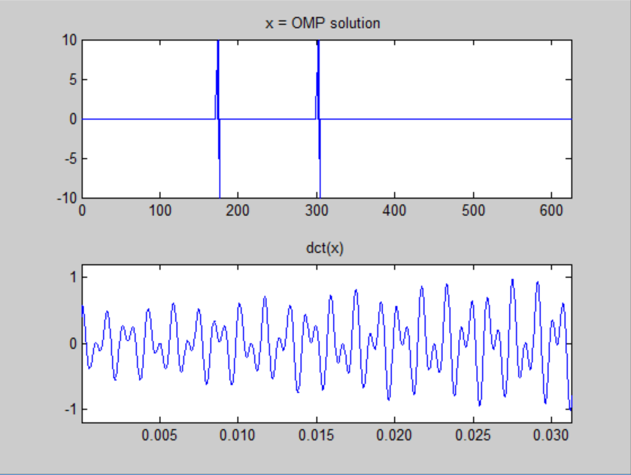
Results
OMP Solution

Slide 9
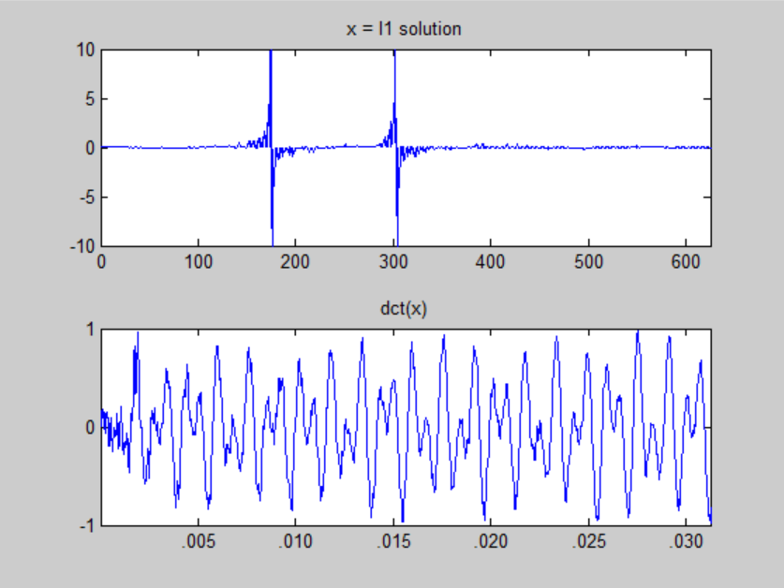
Results
Basis Pursuit Solution

Slide 10
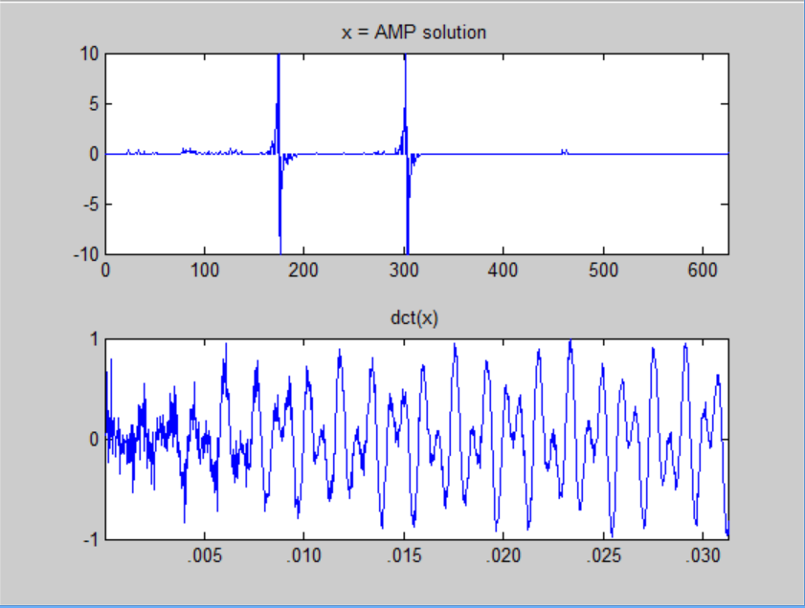
Results
AMP Solution

Slide 11

Conclusion
An analog signal was generated ,Sampling was done by employing the compressive
sampling method and the signal was reconstructed using the following three
techniques:
1)Basis Pursuit
2)Orthogonal Matching Pursuit
3)Approximate Message Passing
A comparison was done between the three abovementioned algorithms in terms of the
following 2 parameters:
1) Time taken to reconstruct the signal :
It was found that OMP takes approximately 10 seconds, AMP takes approximately 15 seconds, Basis Pursuit takes approximately 70 seconds for the given inputs.
2) Error :
The values of error rates for the three schemes are calculated using the following formula

Slide 12
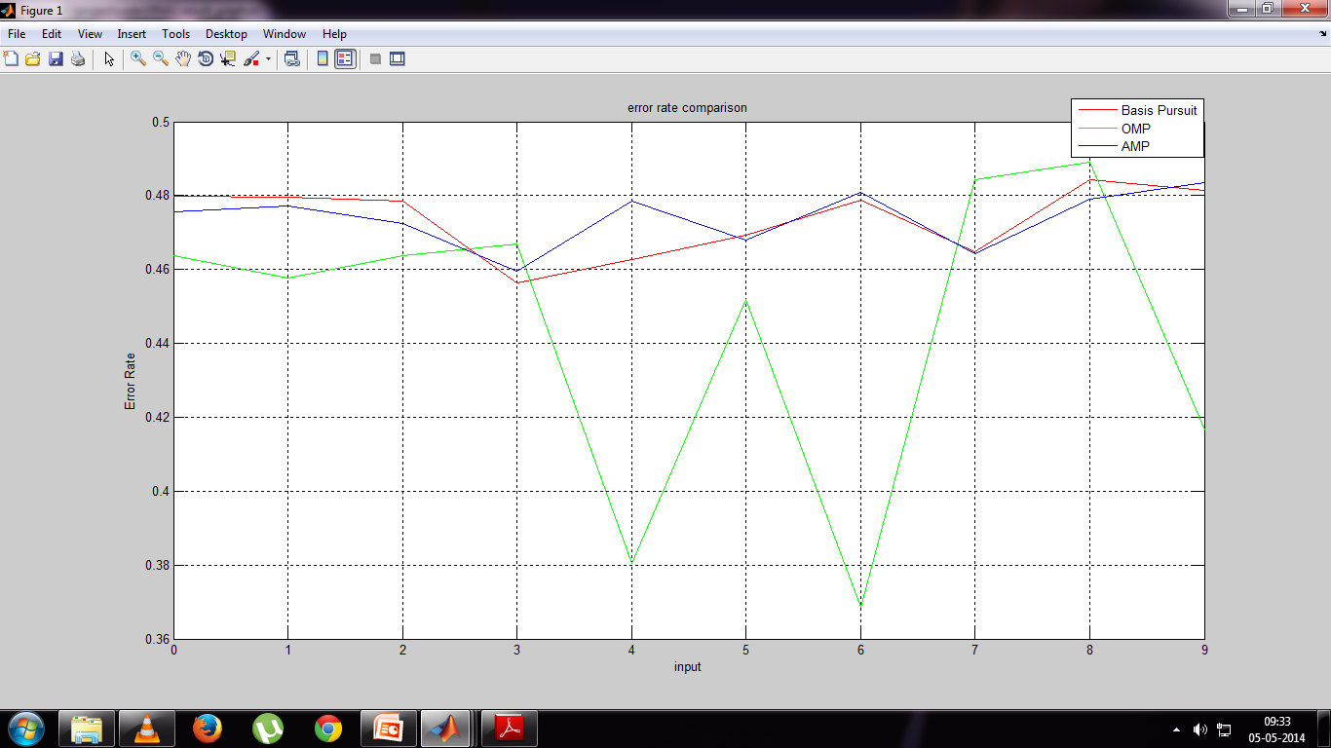
Average error rate for
Basis Pursuit is 0.4736
Orthogonal Matching Pursuit is 0.4443
Approximate Message Passing is 0.4739

Slide 13
References
1. Saad Qaisar, Wafa Iqbal,Rana Muhammad Bilal, Muqaddas Naureen, SungyoungLee, "Compressive Sensing: From Theory to Applications, A Survey", Journal of Communications and Networks, October 2013.
2. D. Donoho, “Compressed sensing,” IEEE Trans. Inform. Theory, April 2006.
3. E. CandÃ¨s , J. Romberg and T. Tao "Robust uncertainty principles: Exact signal reconstruction from highly incomplete frequency information", IEEE Trans. Inform. Theory, 2006.
4. An Introduction To Compressive Sampling Candes, E.J. Wakin, M.B. Signal Processing Magazine, IEEE,2008.
5. Compressed Sensing Reconstruction via Belief Propagation Shriram Sarvotham, Dror Baron and Richard G. Baraniuk Department of Electrical and Computer Engineering Rice University, Houston, TX 77005, USA,July 14, 2006

Slide 14
6. ’Algorithms for Sparse Approximation’,Philip Breen
7. ‘Iterative Thresholding for Sparse Approximations’,Thomas Blumensath and Mike E. Davies, The Journal of Fourier Analysis and Applications
8. ‘Message-passing algorithms for compressed sensing’,David L. Donoho, Arian Maleki, and Andrea Montanaria, Departments of Statistics and Electrical Engineering, Stanford University, September 11, 2009
9. ‘Message Passing Algorithms for Compressed Sensing: I. Motivation and Construction ‘, David L. Donoho, Arian Maleki, and Andrea Montanaria, Departments of Statistics and Electrical Engineering, Stanford University

